Slide 1
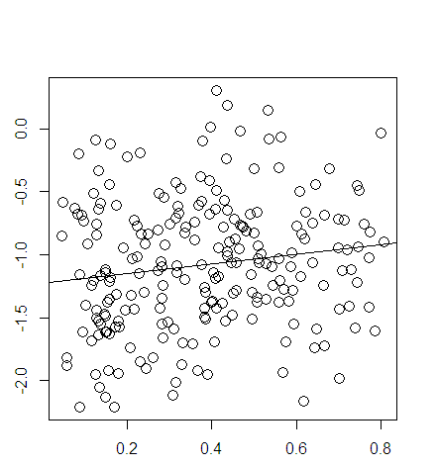
Supplementary Figure 1: Correlation between WRN methylation and mRNA expression levels in 223 CRC samples contained in TCGA data
WRN mRNA expression (microarray)
WRN DNA methylation (HM27)
Pearson correlation = 0.1; p-value = 0.03

