Slide 1
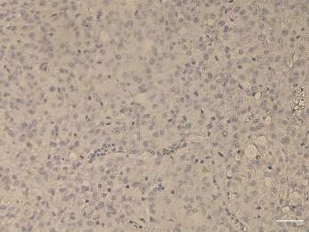
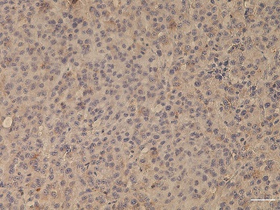
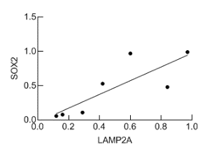
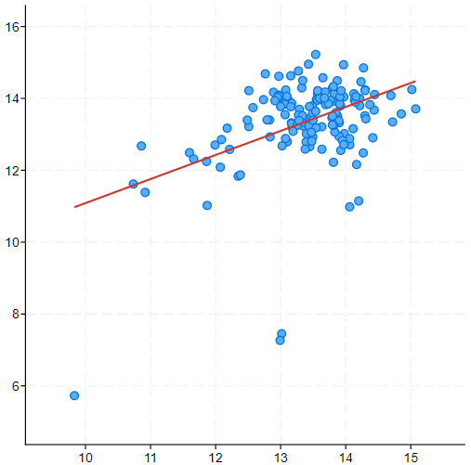
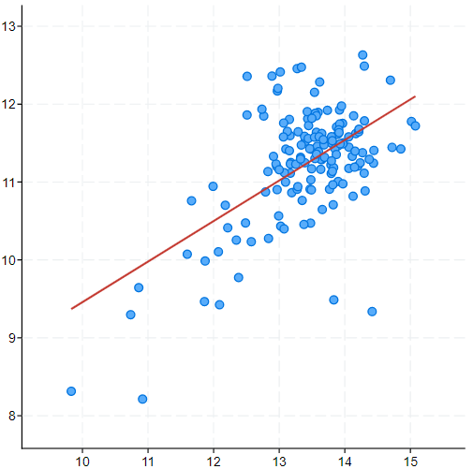
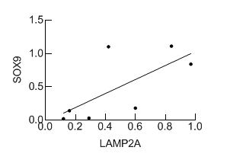
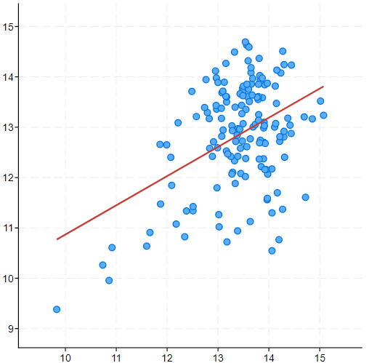
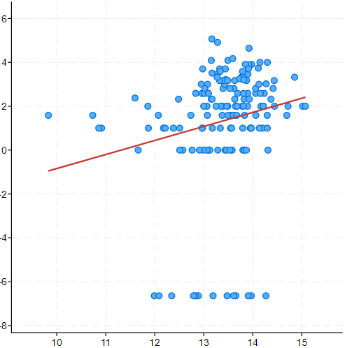
A
-
CSC
LAMP2A
B
C
r = 0.821
p = 0.023
SOX2
SOX2 (log2)
BMI1 (log2)
Spearman: 0.247
Spearman: 0.302
LAMP2 (log2)
LAMP2A
LAMP2 (log2)
LAMP2 (log2)
r = 0.688
p = 0.087
SOX9
SOX9 (log2)
POU5F1 (log2)
Spearman: 0.207
Spearman: 0.244
LAMP2A
LAMP2 (log2)
LAMP2 (log2)
Supp. Fig.1. LAMP2 expression is high in GSCs
(A) Representative images of the immunohistochemical staining of LAMP2A in subcutaneous tumors from parental U87-MG and respective oncospheres (n=2), scale bar= 100 µm; (B) Quantification and Pearson’s correlation of LAMP2A with SOX2 and SOX9 in GBM cell lines; (C) Association study of LAMP2 with stem cell markers SOX2 (p=2.197e-03), SOX9 (p=0.0103), BMI1 (p=5.707e-05) and POU5F1 (p=2.456e-03) in TCGA cohort (cBioPortal for cancer genomics, https://www.cbioportal.org/);
Supp. Figure 1. Auzmendi-Iriarte, et. al.

Slide 2
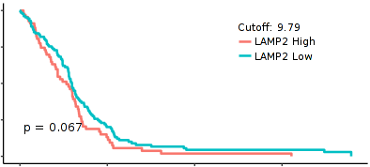
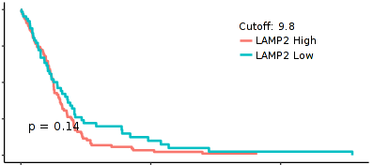
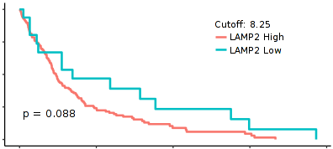
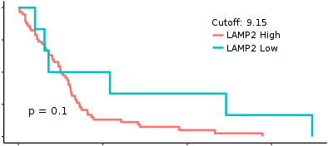
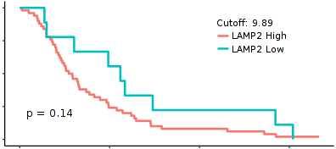
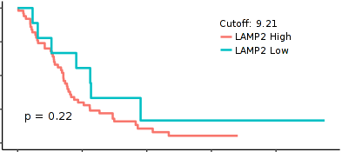
A
Classical
Mesenchymal
Proneural
TCGA
100
High
High
High
75
Low
Low
Low
Survival (%)
50
25
p=0.067
p=0.14
p=0.088
0
0
25
50
75
0
50
100
0
60
120
Time (months)
Time (months)
Time (months)
Rembrandt
100
High
High
High
75
Low
Low
Low
High
Survival (%)
Low
50
25
p=0.1
p=0.14
p=0.22
0
0
25
50
75
0
20
40
60
0
50
100
Time (months)
Time (months)
Time (months)
B
C
Supp. Fig.2. LAMP2 expression does not affect overall survival among GBM subtypes.
(A) Kaplan Meier curves representing survival of patients with low vs high LAMP2 expression in classical (TCGA: n=130 vs n=68; Rembrandt: n=6 vs n=57, respectively), mesenchymal (TCGA: n=66 vs n=99; Rembrandt: n=9 vs n=50, respectively) and proneural (TCGA: n=16 vs n=146; Rembrandt: n=9 vs n=50, respectively) GBM subtypes in TCGA (up) and Rembrandt (down) cohorts. Optimal cutoff points for Kaplan Meier curves were designated by GlioVis database. (B-C) Quantification of CMA activity by puncta per cell in control (NIH3T3, N2A) and GBM cells in B and GNS in C transduced with KFERQ-Dendra CMA reporter, in the presence (n=6) or absence (n=3) of serum. Also in the presence of the oxidative stressor paraquat in the case of GBM cells (n=3).
Supp. Figure 2. Auzmendi-Iriarte, et. al.

Slide 3
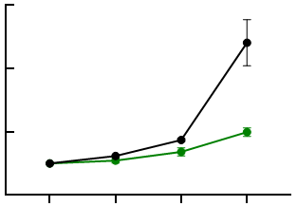
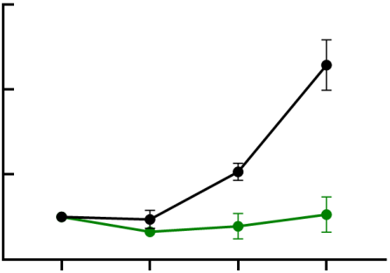
A
B
C
U373
U251
U251 pGK
U251 shL2A
Oncospheres (%)
1^{ry}
2^{ry}
D
E
GNS166
U251
GNS166
P-H3
U251
150
pGK
150
pGK
100
shL2A
100
shL2A
pGK
Number of cells (·10³)
Number of cells (·10³)
50
**
50
*
0
*
***
***
shL2A
0
0
1
3
5
Day:
0
1
3
5
Day:
F
U251
G
U251
H
Supp. Fig. 3. LAMP2A knock-down impairs GSC activity.
(A) Relative quantification of primary oncospheres in pGK and shL2A U373 cells (n≥3); (B) Relative mRNA expresión of LAMP2A, SOX2 and SOX9 in pGK vs shL2A U251 (n=3); (C) Relative number of formed colonies of pGK and shL2A after LAMP2A rescue (n=3); (D) Cell count of pGK and shL2A GNS166 (left) and U251 (right) cells at day 1, 3 and 5 after cell seeding (n=3); (E) Representative images of immunofluorescence of p-histone 3 (p-H3) in pGK and shL2A GNS166 and U251 cells, scale bar = 100µm; (F) Cell count of pGK and shL2A after LAMP2A rescue (n=3); (G) Number of proliferating cells at day 5 relative to day 1 in pGK and shL2A U251 cells, after treatment with 20 µM QX77 CMA activator (n=3); (H) Relative cell viability of shL2A GNS166 and U251 cells after treatment with 2 mM and 250 µM TMZ respectively (n=3).
Supp. Figure 3. Auzmendi-Iriarte, et. al.

Slide 4
A
B
Supp. Fig. 4. LAMP2A knock-down alters proteome of glioma cells.
(A) Representative dotplot indicating biological processes altered in pGK vs. shL2A GNS166 cells (n=4). The size of the circles represents the protein enrichment in each process; (B) Ontology analysis based on Reactome database of altered proteome in pGK vs shL2A U251 (n=4).
Supp. Figure 4. Auzmendi-Iriarte, et. al.

Slide 5
A
B
C
D
*
U251
R/A
Oligomycin
MitoSox intensity (%)
FCCP
shL2A +
BHA
shL2A
Supp. Fig. 5. LAMP2A knock-down impairs mitochondrial function of glioma cells.
(A) Relative quantification of immunoblots of mitochondrial markers TIM23 and MRP-S23 in GNS166 (n=4) andU251 (n=3); (B) Normalized OCR response in pGK and shL2A U251 at basal conditions and after consecutive addition of Oligomycin 1 μM, FCCP 1 μM and Rotenone/Antimycin A 1 μM. A representative experiment is shown from a total of n=3; (C) Relative quantification of mitochondrial ROS by MitoSox signal of pGK and shL2A GNS166, after treatment with antioxidant 100 µM BHA (n=3); (D) Relative quantification of mitochondrial ROS in shL2A GNS166, after treatment with 100 µM BHA.
Supp. Figure 5. Auzmendi-Iriarte, et. al.

Slide 6
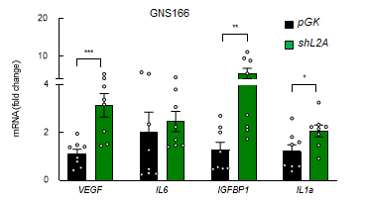
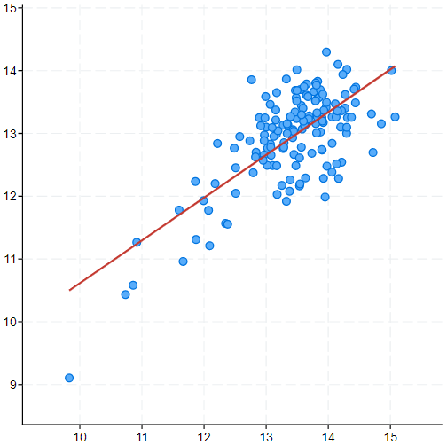
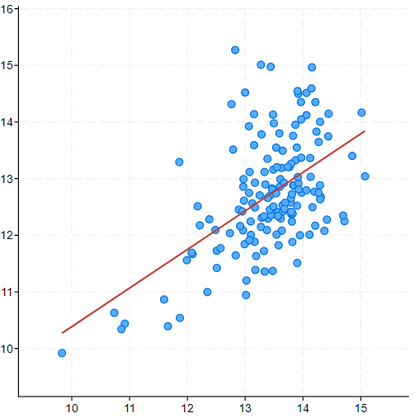
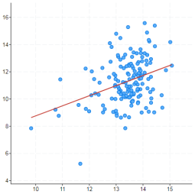
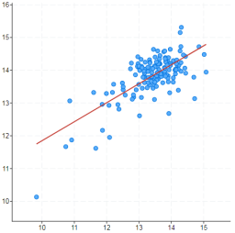
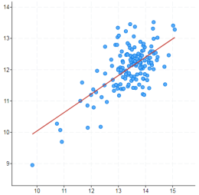
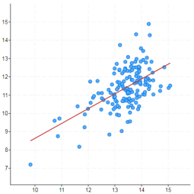
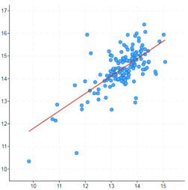
A
B
C
D
GNS179
pGK
shL2A
E
STAT3 (log2)
STAT1 (log2)
MX1 (log2)
Spearman: 0.512
Spearman: 0.441
Spearman: 0.279
LAMP2 (log2)
LAMP2 (log2)
LAMP2 (log2)
AP2M1 (log2)
KIF5B (log2)
CTSC (log2)
CTSD (log2)
Spearman: 0.503
Spearman: 0.432
Spearman: 0.501
Spearman: 0.598
LAMP2 (log2)
LAMP2 (log2)
LAMP2 (log2)
LAMP2 (log2)
Supp. Fig. 6. LAMP2A knock-down reduces cytokine secretion of GSCs.
(A) Relative quantification of immunoblots of pSTAT1, STAT1, MX1, pSTAT3 and STAT3 in pGK vs shL2A GNS166 (n=4) and U251 (n=3); (B) Relative quantification of individual secreted cytokines by GNS166 pGK vs shL2A (p < 0.05, n=4); (C) Relative mRNA expression of LAMP2A, IGFBP2, IGFBP4, ANG, Eotaxin-3, SDF1 and IP10 in pGK vs shL2A GNS179 cells (n=3); (D) VEGF, IL6, IGFBP1 and IL1α relative mRNA expression in GNS166 pGK and shL2A (n≥8); (E) Association study of LAMP2 with STAT3 (p=1.64e-11), STAT1 (p=1.32e-08) and MX1 (p=4.960e-04), and AP2M1 (p=3.86e-11), KIF5B (UKHC, p=2.82e-08), CTSC (DPP1, p=4.78e-11), and CTSD (Cathepsin D, p=4.07e-16) in TCGA cohort (cBioPortal for cancer genomics, https://www.cbioportal.org/).
Supp. Figure 6. Auzmendi-Iriarte, et. al.

Slide 7
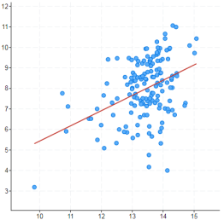
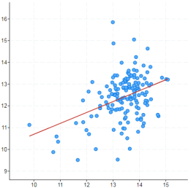
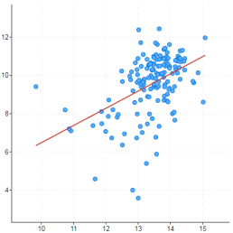
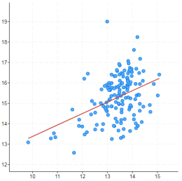
A
GNS179
pGK
shL2A
B
ITGB3 (log2)
LAMC1 (log2)
COL4A5 (log2)
FN1 (log2)
Spearman: 0.327
Spearman: 0.291
Spearman: 0.439
Spearman: 0.333
LAMP2 (log2)
LAMP2 (log2)
LAMP2 (log2)
LAMP2 (log2)
Supp. Fig. 7. LAMP2 positively correlates with ECM interaction markers.
(A) Relative quantification of indicated genes in pGK vs shL2A GNS179 (n=3); (B) Association study of LAMP2 with ITGB3 (p= 3.949e-05), LAMC1 (p= 2.826e-04), COL4A5 (p= 1.57e-08) and FN1 (p= 2.787e-05) in TCGA cohort (cBioPortal for cancer genomics, https://www.cbioportal.org/).
Supp. Figure 7. Auzmendi-Iriarte, et. al.

Slide 8
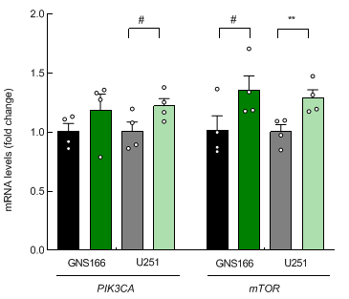






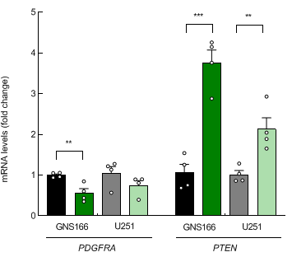
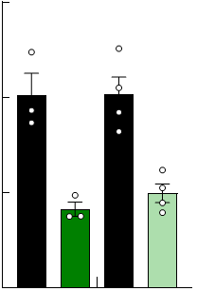
A
B
pGK
shL2A
GNS166
U251
pGK
shL2A
pGK
shL2A
p-AKT
50 kDa
AKT
50 kDa
β-actin
37 kDa
C
D
1.5
**
**
pGK
pGK
shL2A
shL2A
1.0
Cyclin A (fold change)
0.5
0
GNS166
U251
Supp. Fig. 8. LAMP2A knock-down alters Cyclin A and PI3K/AKT/mTOR pathway.
(A) Relative mRNA expression of PIK3CA and mTOR in both GNS166 and U251 pGK / shL2A (n=4); (B) Representative immunoblots of p-AKT and total AKT in both GNS166 and U251 pGK / shL2A (n=3); (C) PDGFRA and PTEN and (D) Cyclin A mRNA expression in both GNS166 (n=3/4) and U251 (n=4) pGK / shL2A.
Supp. Figure 8. Auzmendi-Iriarte, et. al.

