Slide 1
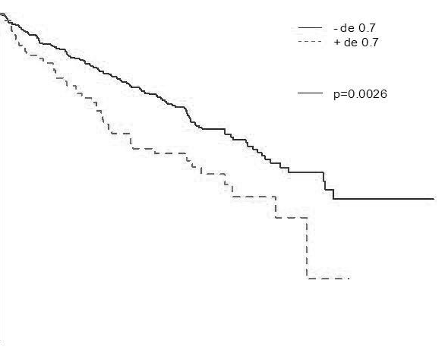
A
VEGFC | Total cases | Cases deceazed | Median survival (months)
Low | 415 | 123 (29.6 %) | 90.4
High | 98 | 42 (42.8 %) | 62.8
100
p = 0.0026
80
60
Overall survival (%)
40
20
VEGFC low
VEGFC high
**
0
0 20 40 60 80 100 120
Months
B
VEGFC | Low | High | P value
M1 (%) | 13.8 | 24.2 | 0.019
C
 | p value | Risk ratio [IC95% OR]
VEGFC high | 0.000253 | 2.418 [ 1.493 - 3.916 ]
Stage 3/4 | 0.000066 | 2.801 [ 1.672 - 4.693 ]
M1 | 0.003148 | 2.134 [ 1.276 - 3.568 ]
N1 | 0.769254 | 0.901 [ 0.445 - 1.826 ]
Supplementary Figure 6, Dufies et al

