Slide 1
Supplementary Materials-Supplemental figure legends
Fig. S1. 983BR and 1205LuR are resistant to vemurafenib.
Fig. S2. Inhibition of mTOR signaling pathway is critical for palbociclib-induced senescence in 983BR vemurafenib resistant cells, related to Figure. 6.
Fig. S3. Over expression of mTOR signaling overrides palbociclib-induced senescence in 983BR vemurafenib resistant cells, related to Figure. 7.
Fig. S4. Rb expression in the palbociclib resistant cells.
Fig. S5. Rapamycin negatively regulates geroconversion in esophageal cancer cell lines.
Fig. S6. Palbociclib has no cytotoxicity in 983BR vemurafenib resistant cells.
Supplemental Fig. 1 983BR and 1205LuR are resistant to vemurafenib.
Cell cycle analysis of 983B, 983BR, 1205Lu, and 1205LuR cells treated with or without vemurafenib for 2 days by FACS.
Supplemental Fig. 2 Inhibition of mTOR signaling pathway is critical for palbociclib-induced senescence in 983BR vemurafenib resistant cells, related to Figure. 6
(A) QPCR analysis of 1205Lu cells treated with palbociclib for 8 days, PR1, PR2, PR3, PR6, and PR7 using a pair of primers to mTOR, Raptor, Rictor, S6K, and AKT1. Data normalized by GAPDH is shown. (B) 2.5x10³ of 983BR cells were plated and treated with either rapamycin at 50nM, palbociclib, or both rapamycin and palbociclib for either 3 days or 8 days, and then cells were cultured for additional 14 days after palbociclib was washed out. Colonies were visualized by Giemsa stain. (C) Cell cycle analysis of 1205Lu cells treated with or without palbociclib for 1 day, and palbociclib-exposed 1205Lu PR1, PR2, PR3, PR6, and PR7 by FACS.
Supplemental Fig. 3 Overexpression of mTOR signaling overrides palbociclib-induced senescence in 983BR vemurafenib resistant cells, related to Figure. 7
(A) 2.5x10³ of 983BR cells infected with control, Raptor, Myr-Akt, or S6K were plated and treated with or without palbociclib for 8 days, and then cells were cultured for additional 14 days after palbociclib was washed out. Colonies were visualized by Giemsa stain. (B) Western blot analysis of the lysates from 983BR cells infected with control, Raptor, Myr-Akt, or S6K for Raptor, Pan Akt, and S6K.
Supplemental Fig. 4 Rb expression in the palbociclib resistant cells.
(A) QPCR analysis of 1205Lu cells treated with or without palbociclib for 8 days, PR1, PR2, PR3, PR6, and PR7 using a pair of primer to Rb1. Data normalized by GAPDH. (B) Western blot analysis of the lysates from 1205Lu cells, and PR2, PR6, and PR7 cells cultured without palbociclib for 2 weeks for pRb (S780) and Rb (total).

Slide 2
Supplemental Fig. 5 Rapamycin negatively regulates geroconversion in esophageal cancer cell lines.
2.5x10³ of TE7 cells were plated and treated with either rapamycin at 50nM, palbociclib, or both rapamycin and palbociclib for 8 days, and then cells were cultured for additional 14 days after palbociclib was washed out. Colonies were visualized by Giemsa stain.
Supplemental Fig. 6 Palbociclib has no cytotoxicity in 983BR vemurafenib resistant cells.
(A) Annexin V staining of 983B (vemurafenib sensitive) and 983BR (vemurafenib resistant) cells treated with DMSO, palbociclib 1μM, palbociclib 5μM, or palbociclib 10μM for 2 days to examine the cytotoxicity of palbociclib. (B) Annexin V staining of 983BR (vemurafenib resistant) cells infected with vector or p19^{INK4d} to determine the cytotoxicity of the expression of p19^{INK4d}.

Slide 3
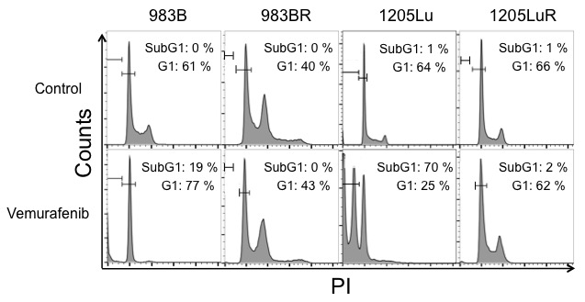
Supplemental Fig. 1
Supplemental Fig. 1 983BR and 1205LuR are resistant to vemurafenib.
Cell cycle analysis of 983B, 983BR, 1205Lu, and 1205LuR cells treated with or without vemurafenib for 2 days by FACS.

Slide 4
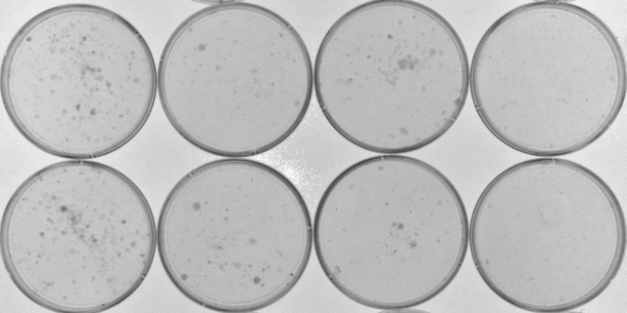
Supplemental Fig. 2
A.
B.
Control
Rapamycin
Palbociclib
Palbociclib+Rapamycin
Relative expression levels
3 days
8 days
C.
Supplemental Fig. 2 Inhibition of mTOR signaling pathway is critical for palbociclib-induced senescence in 983BR vemurafenib resistant cells, related to Figure. 6
(A) QPCR analysis of 1205Lu cells treated with palbociclib for 8 days, PR1, PR2, PR3, PR6, and PR7 using a pair of primers to mTOR, Raptor, Rictor, S6K, and AKT1. Data normalized by GAPDH is shown. (B) 2.5x10³ of 983BR cells were plated and treated with either rapamycin at 50nM, palbociclib, or both rapamycin and palbociclib for either 3 days or 8 days, and then cells were cultured for additional 14 days after palbociclib was washed out. Colonies were visualized by Giemsa stain. (C) Cell cycle analysis of 1205Lu cells treated with or without palbociclib for 1 day, and palbociclib-exposed 1205Lu PR1, PR2, PR3, PR6, and PR7 by FACS.

Slide 5
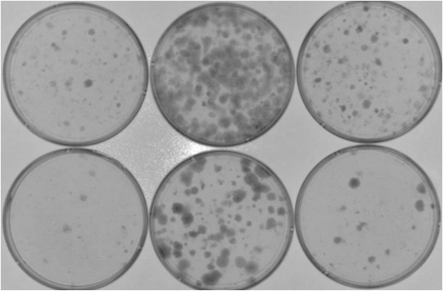
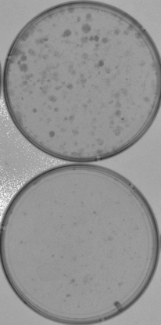
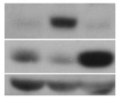
Supplemental Fig. 3
A.
Vector
Raptor
Myr-Akt
S6K
Control
Palbociclib
B.
Control
Raptor
Myr-Akt
Raptor
Control
S6K
Pan Akt
S6K
βactin
βactin
Supplemental Fig. 3 Overexpression of mTOR signaling overrides palbociclib-induced senescence in 983BR vemurafenib resistant cells, related to Figure. 7
(A) 2.5x10³ of 983BR cells infected with control, Raptor, Myr-Akt, or S6K were plated and treated with or without palbociclib for 8 days, and then cells were cultured for additional 14 days after palbociclib was washed out. Colonies were visualized by Giemsa stain. (B) Western blot analysis of the lysates from 983BR cells infected with control, Raptor, Myr-Akt, or S6K for Raptor, Pan Akt, and S6K.

Slide 6
Supplemental Fig. 4
A.
B.
Control
PR2
PR6
PR7
Relative expression levels
pRb (S780)
Rb (total)
βactin
Supplemental Fig. 4 Rb expression in the palbociclib resistant cells.
(A) QPCR analysis of 1205Lu cells treated with or without palbociclib for 8 days, PR1, PR2, PR3, PR6, and PR7 using a pair of primer to Rb1. Data normalized by GAPDH. (B) Western blot analysis of the lysates from 1205Lu cells, and PR2, PR6, and PR7 cells cultured without palbociclib for 2 weeks for pRb (S780) and Rb (total).

Slide 7
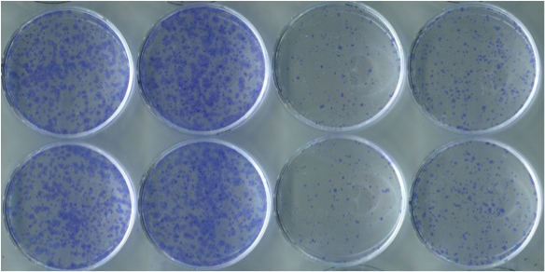
Supplemental Fig. 5
Control
Rapamycin
Palbociclib
Palbociclib+Rapamycin
Supplemental Fig. 5 Rapamycin negatively regulates geroconversion in esophageal cancer cell lines.
2.5x10³ of TE7 cells were plated and treated with either rapamycin at 50nM, palbociclib, or both rapamycin and palbociclib for 8 days, and then cells were cultured for additional 14 days after palbociclib was washed out. Colonies were visualized by Giemsa stain.

Slide 8
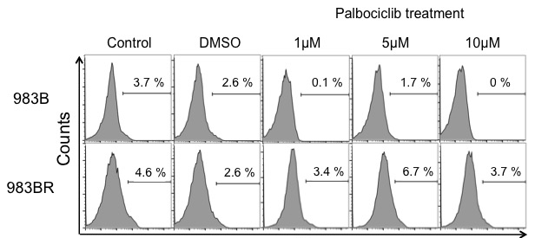
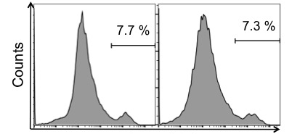
Supplemental Fig. 6
A.
Annexin V
B.
Vector
p19^{INK4d}
983BR
Annexin V
Supplemental Fig. 6 Palbociclib has no cytotoxicity in 983BR vemurafenib resistant cells.
(A) Annexin V staining of 983B (vemurafenib sensitive) and 983BR (vemurafenib resistant) cells treated with DMSO, palbociclib 1μM, palbociclib 5μM, or palbociclib 10μM for 2 days to examine the cytotoxicity of palbociclib. (B) Annexin V staining of 983BR (vemurafenib resistant) cells infected with vector or p19^{INK4d} to determine the cytotoxicity of the expression of p19^{INK4d}.

