Slide 1
Covariate | AD N (%) | SCC N (%) | p-values
Sex | 63/63 | 96/96 | 0.097
M | 31 (49.2%) | 60 (62.5%)
F | 32 (50.8%) | 36 (37.5%)
Smoking Status | 48/63 | 84/96 | 0.232
Current | 24 (50%) | 51 (60.7%)
Former | 20 (41.6%) | 29 (34.5%)
Never | 4 (8.3%) | 4 (4.8%)
Pathologic Stage | 63/63 | 94/96 | 0.001
I | 35 (55.5%) | 24 (25.5%)
II | 23 (36.5%) | 29 (31%)
III & IV | 5 (8%) | 41 (43.6%)
Degree of Differentiation | 60/63 | 93/96 | 0.224
Poor | 11 (18.3%) | 22 (23.7%)
Moderate | 41 (68.3%) | 64 (68.8%)
Well | 8 (13.3%) | 7 (7.5%)
Survival | 50/63 | 85/96 | 0.286
Alive | 43 (86%) | 69 (81.2%)
Dead | 7 (14%) | 16 (18.8%)
Supplemental Table 1

Slide 2
A.
B.
Flow Cytometry
H520 Rapa
Veh
16h
24h
Flow Cytometry
PD-L1
pS6^{S235/236}
α-tubulin
H520 Rapa
Supplementary Figure 1

Slide 3
A.
U0126
B.
CL30
IO33
24h
CL25
H157 U0126
Veh
2h
6h
24h
Veh
2h
6h
Veh
2h
6h
24h
2h
6h
Veh
PD-L1
PD-L1
pERK^{T202/Y204}
pERK^{T202/Y204}
ERK
α-tubulin
pAKT^{S473}
Veh
16h
AKT
α-tubulin
U0126
Supplementary Figure 2

Slide 4
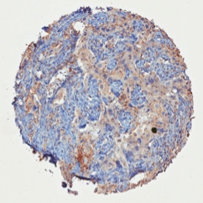
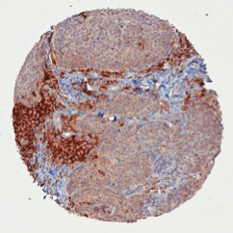
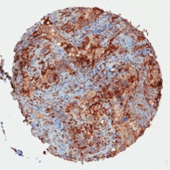
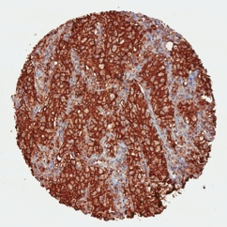
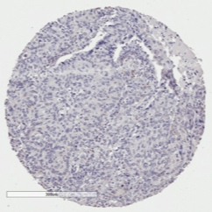
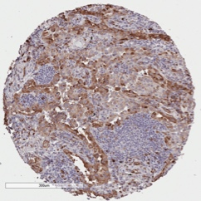
A.
Membrane PD-L1 Scoring Scale
C.
pS6^{S235/236} Scoring
0
+1
+2
+3
Negative
Positive
B.
Adenocarcinoma TMA
Stain | Lung Tissue | Location | 0 | +1 | +2 | +3
PD-L1 | Tumor | Membrane | 42 (67.7%) | 4 (6.5%) | 6 (9.7%) | 10 (16%)
 | Normal | Membrane | 62 (100%) | 0 | 0 | 0
Squamous Cell Carcinoma TMA
Stain | Lung Tissue | Location | 0 | +1 | +2 | +3
PD-L1 | Tumor | Membrane | 46 (47.9%) | 12 (12.5%) | 14 (14.6%) | 24 (25%)
D.
Adenocarcinoma TMA
Stain | Tissue | Negative | Positive
pS6^{S235/236} | Tumor | 9 (14.5%) | 53 (85.5%)
Squamous Cell Carcinoma TMA
Stain | Tissue | Negative | Positive
pS6^{S235/236} | Tumor | 33 (34.4%) | 63 (65.6%)
Supplementary Figure 3

Slide 5
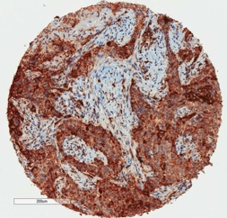
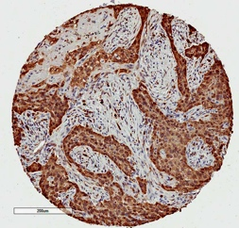
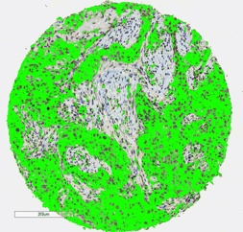
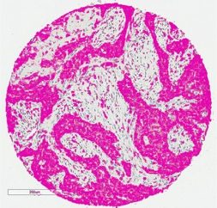
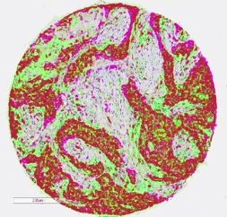
PD-L1
pS6^{S235/236}
IHC
Overlay
Pseudocolor
Supplementary Figure 4.

Slide 6
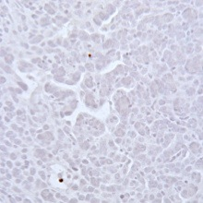
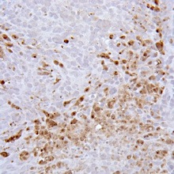
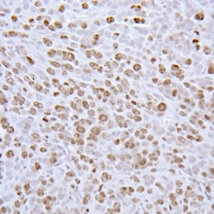
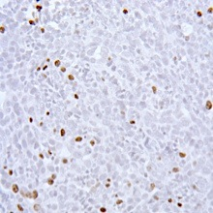
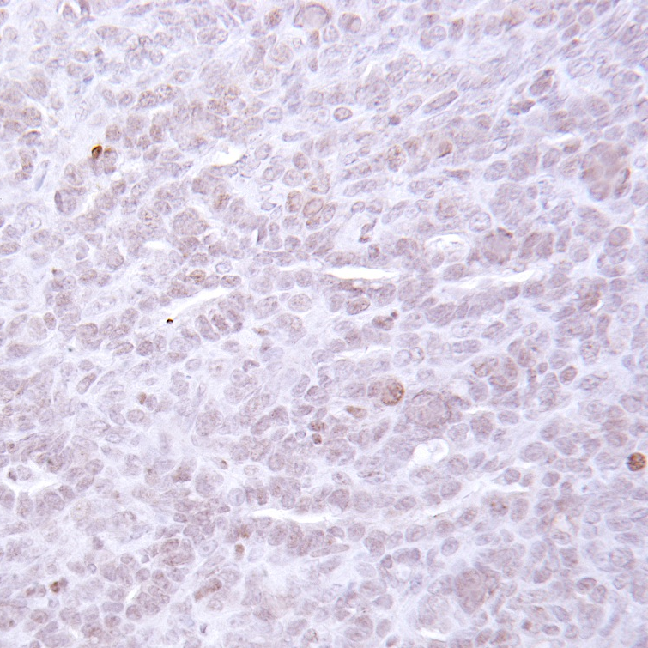
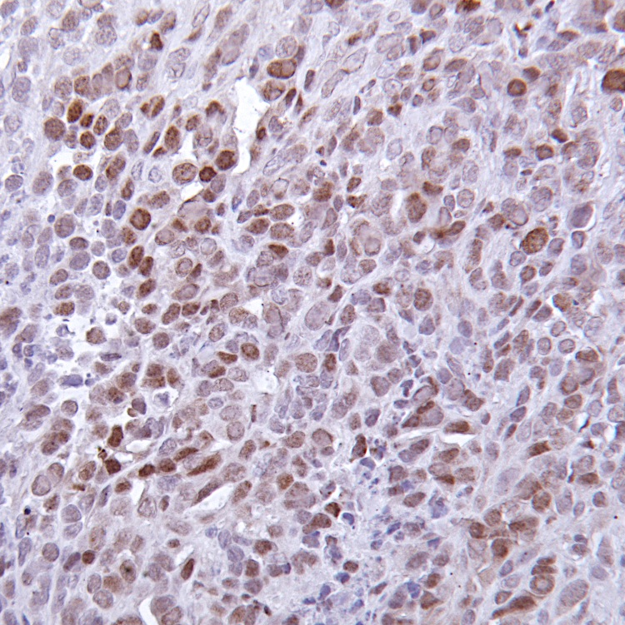
A.
B.
C.
IO33 cells
sub-cut.
Tumors 3-5mm
Sacrifice 3wks tx
*
*
N=6
4.5mg/kg LD; 1.5mg/kg vehicle QOD and 150μg IgG weekly i.p.
n.s.
N=6
4.5mg/kg LD; 1.5mg/kg rapa QOD and 150μg αPD-1 weekly i.p.
D.
E.
*
F.
Veh&IgG
Rapa&αPD-1
*
*
*
Cl. Caspase 3
n.s.
*
Ki67
CD4⁺
CD8⁺
CD4⁺FoxP3⁺
*
Supplemental Figure 5
pHP1-γ

Slide 7
A.
IO33 cells sub-cut.
Tumors 3-5mm
B.
C.
Sacrifice 3 weeks
N=6
150μg IgG weekly i.p.
N=6
150μg αPD-1 weekly i.p.
4.5mg/kg LD; 1.5mg/kg rapa QOD
N=6
Syngeneic A/J mice
4.5mg/kg LD; 1.5mg/kg veh QOD
**
N=6
N=6
Rapa&IgG
N=4
Veh&αPD-1
N=6
Rapa&αPD-1
D.
E.
CD8⁺
CD4⁺FoxP3⁺
Supplementary Figure 6.

